Slide 1
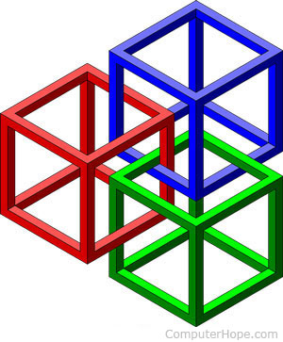
IS457 Mobile Applications
Lecture 2
Mobile Framework

Slide 2
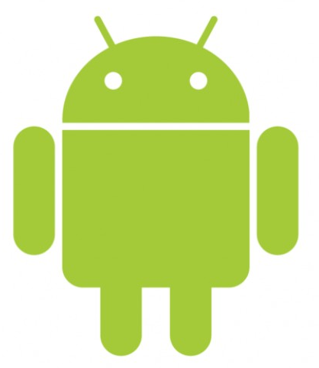
Android Platform
‘android’ signifies “being human”.
Open, free designed primarily for touch screen devices.
Designed in 2003, by Rich Miner, Nick Sears, and Chris White, in Palo Alto, California.
In 2005, Android was purchased by Google.
Operating system based on the Linux 2.6 kernel

Slide 3
Android Framework

Slide 4
